Slide 1

Welcome
GUI Programming
with Java
Session 9
Dialogs

Slide 2

Objectives
We will look at…
  Creating Dialogues

Slide 3
A dialog is basically a window that is more limited than frame.
Several classes support dialogs.
The ProgressMonitor class can put up a dialog that shows the progress of an operation.
To bring up a print dialog, you can use the Printing API.
To create custom dialogs, use the JDialog class directly.

Slide 4
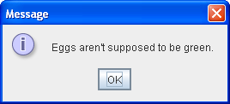
The code for simple dialogs can be minimal. For example, here's an informational dialog:
Here is the code that creates and shows it:
JOptionPane.showMessageDialog(frame, "Eggs aren't supposed to be green.");

Slide 5
An Overview of Dialogs
Every dialog is dependent on a frame.
When that frame is destroyed, so are its dependent dialogs.
When the frame is iconified, its dependent dialogs disappear from the screen.
When the frame is deiconified, its dependent dialogs return to the screen. The AWT automatically provides this behavior.

Slide 6
modal Dialogs
A dialog can be modal.
When a modal dialog is visible, it blocks user input to all other windows in the program.
The JDialogs that JOptionPane creates are modal.
To create a non-modal dialog, you must use the JDialog class directly.

Slide 7
Dialog Examples
Lets take a look at the DialogDemo.java example in the sample 2 – dialog folder
This sample demonstrates many of the different types of dialogs that we can use in Java

Slide 8
JOptionPane Features
Using JOptionPane, you can create and customize several different kinds of dialogs.
JOptionPane provides support for laying out standard dialogs, providing icons, specifying the dialog's title and text, and customizing the button text.
Other features allow you to customize the components the dialog displays and specify where the dialog should appear onscreen.
You can even specify that an option pane put itself into an internal frame (JInternalFrame) instead of a JDialog.

Slide 9
JOptionPane Features
JOptionPane's icon support lets you easily specify which icon the dialog displays.
You can use a custom icon, no icon at all, or any one of four standard JOptionPane icons
  Question
  Information
  Warning
  Error

Slide 10
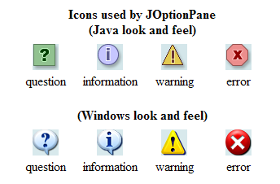
Each look and feel has its own versions of the four standard icons. The following figure shows the icons used in the Java look and feel.

Slide 11
Creating and Showing Simple Dialogs
For most simple modal dialogs, you create and show the dialog using one of JOptionPane's showXxxDialog methods.
If your dialog should be an internal frame, then add Internal after show — for example, showMessageDialog changes to showInternalMessageDialog.

Slide 12
The two most useful showXxxDialog methods are showMessageDialog and showOptionDialog
The showMessageDialog method displays a simple, one-button dialog.
The showOptionDialog method displays a customized dialog — it can display a variety of buttons with customized button text, and can contain a standard text message or a collection of components.

Slide 13
showMessageDialog
Lets take a look at some examples

Slide 14
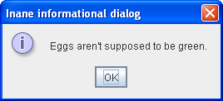
JOptionPane.showMessageDialog(frame, "Eggs aren't supposed to be green.");

Slide 15
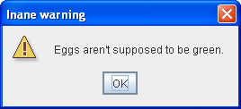
JOptionPane.showMessageDialog(frame, "Eggs aren't supposed to be green.", "Inane warning", JOptionPane.WARNING_MESSAGE);

Slide 16
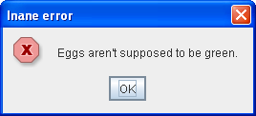
JOptionPane.showMessageDialog(frame, "Eggs aren't supposed to be green.", "Inane error", JOptionPane.ERROR_MESSAGE);

Slide 17
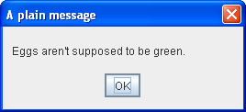
JOptionPane.showMessageDialog(frame, "Eggs aren't supposed to be green.", "A plain message", JOptionPane.PLAIN_MESSAGE);

Slide 18
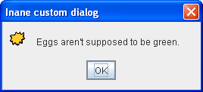
JOptionPane.showMessageDialog(frame, "Eggs aren't supposed to be green.", "Inane custom dialog", JOptionPane.INFORMATION_MESSAGE, icon);

Slide 19
showOptionDialog
Lets take a look at some examples

Slide 20
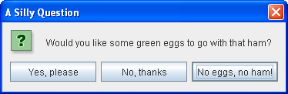
//Custom button text
Object[] options = {"Yes, please", "No, thanks", "No eggs, no ham!"};
int n = JOptionPane.showOptionDialog(frame, "Would you like some green eggs to go " + "with that ham?", "A Silly Question", JOptionPane.YES_NO_CANCEL_OPTION, JOptionPane.QUESTION_MESSAGE, null, options, options[2]);

Slide 21
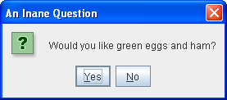
//default icon, custom title
int n = JOptionPane.showConfirmDialog( frame, "Would you like green eggs and ham?", "An Inane Question", JOptionPane.YES_NO_OPTION);

Slide 22
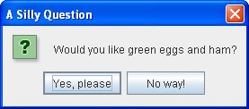
Object[] options = {"Yes, please", "No way!"};
int n = JOptionPane.showOptionDialog(frame, "Would you like green eggs and ham?", "A Silly Question", JOptionPane.YES_NO_OPTION, JOptionPane.QUESTION_MESSAGE, null, //don't use a custom Icon options, //the titles of buttons options[0]); //default button title

Slide 23
Return Values
As the previous code snippets showed, the showMessageDialog, showConfirmDialog, and showOptionDialog methods return an integer indicating the user's choice.
The values for this integer are YES_OPTION, NO_OPTION, CANCEL_OPTION, OK_OPTION, and CLOSED_OPTION.
Except for CLOSED_OPTION, each option corresponds to the button the user pressed. When CLOSED_OPTION is returned, it indicates that the user closed the dialog window explicitly, rather than by choosing a button inside the option pane.
Even if you change the strings that the standard dialog buttons display, the return value is still one of the pre-defined integers. For example, a YES_NO_OPTION dialog always returns one of the following values: YES_OPTION, NO_OPTION, or CLOSED_OPTION.

Slide 24
showInputDialog
Lets take a look at some examples

Slide 25
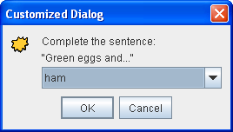
The only form of showXxxDialog that doesn't return an integer is showInputDialog, which returns an Object instead.
This Object is generally a String reflecting the user's choice.

Slide 26
Object[] possibilities = {"ham", "spam", "yam"};
String s = (String)JOptionPane.showInputDialog(
frame,
"Complete the sentence:\n"
+ "\"Green eggs and...\"",
"Customized Dialog",
JOptionPane.PLAIN_MESSAGE,
icon,
possibilities,
"ham");
//If a string was returned, say so.
if ((s != null) && (s.length() > 0)) {
setLabel("Green eggs and... " + s + "!"); return;
}
//If you're here, the return value was null/empty.
setLabel("Come on, finish the sentence!");

Slide 27
End of Session
Exercises:
Create three sample JFrames. Demonstrate how to create the following using the three JFrames:
  A simple message dialog
  A options dialog with at least OK and Cancel
  An input dialog to input some information and output to the screen what was selected

